Slide 1

Deploying containerized Qt applications on embedded systems
Presented by Toradex

Slide 2

Valter Minute
@VMinute on twitter
Works for Toradex AG (www.toradex.com)
Working on devices since 1998

Slide 3

Stefan Eichenberger
Works for Toradex AG (www.toradex.com)
Working on devices since 2008

Slide 4

ABOUT
YOU
Software developers?
Embedded
developers?
Mobile developers?
Linux users?
Docker users?

Slide 5
AGENDA
Containers
Containers and Devices
Containers and Qt
Demo
Q&A

Slide 6
CONTAINERS

Slide 7
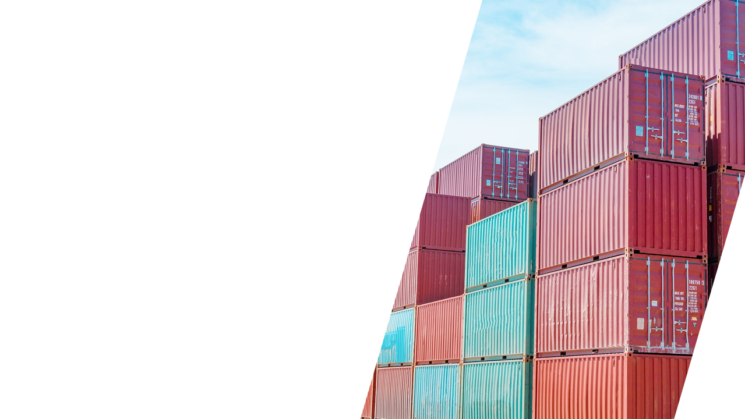
ABOUT
CONTAINERS
An intermodal container is a 20- or 40-feet long metal box
They became popular in late 40s early 50s, boomed in the 60s
Fixed size, well-defined specs
All containers look the same, they are boring
Containers can be easily loaded on ships, trains, trucks
Containers defined a standardized way to ship goods

Slide 8
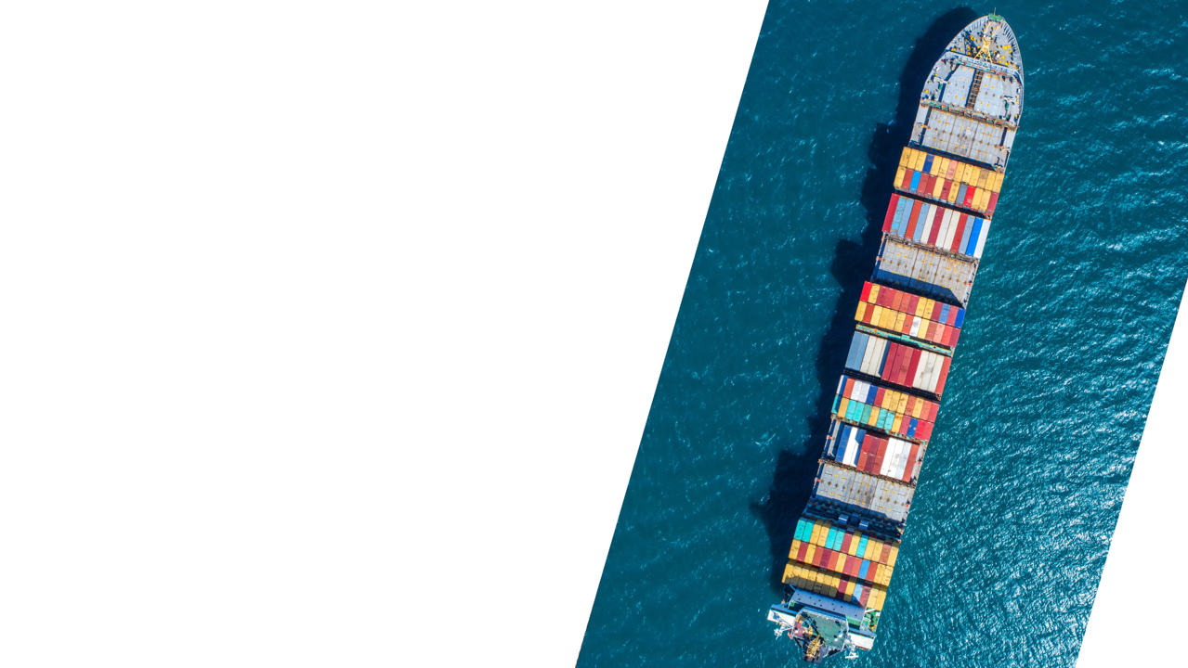
HOW CONTAINERS
CHANGED THE
WORLD
Before containers, ports were a huge mess of different ships, cranes, warehouses etc. one for each kind of transported good
6K container ships, 20 million containers moving in this moment

Slide 9
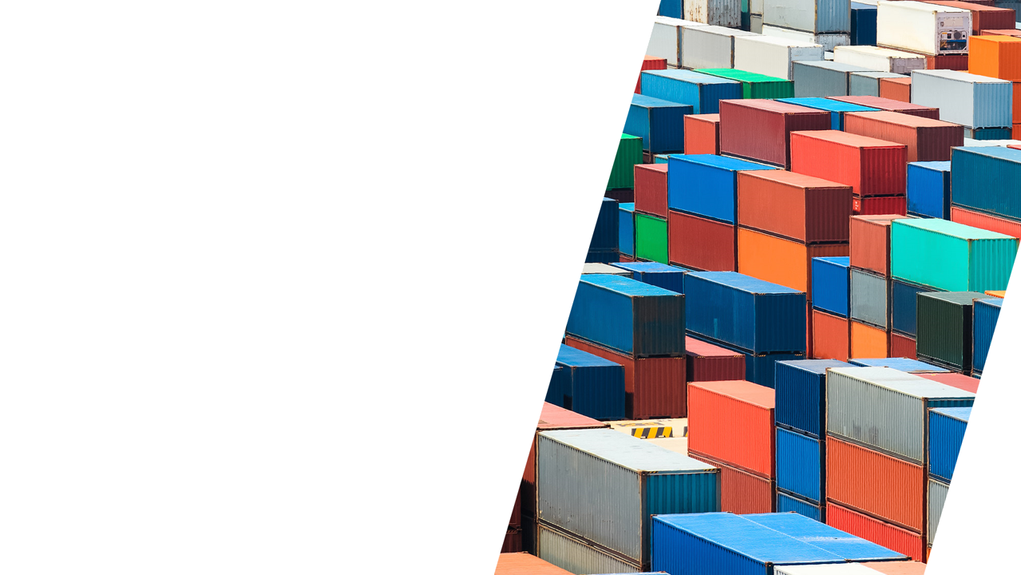
DOES ONE SIZE
FITS ALL?
NO!
Some containers are not filled completely
Some products had to be changed to better fit inside containers
Containers dictate the size and shape of many products
Some kinds of materials or goods are still not shipped inside containers (oil, grains, cars)

Slide 10
CONTAINERS IN
SOFTWARE
Lightweight Virtual Machine
User-mode virtualization
Isolation
Portability
Native drivers
Easy way to package software applications
All user-mode dependencies in the same package
Fully dedicated environment
Easy to clone and distribute

Slide 11
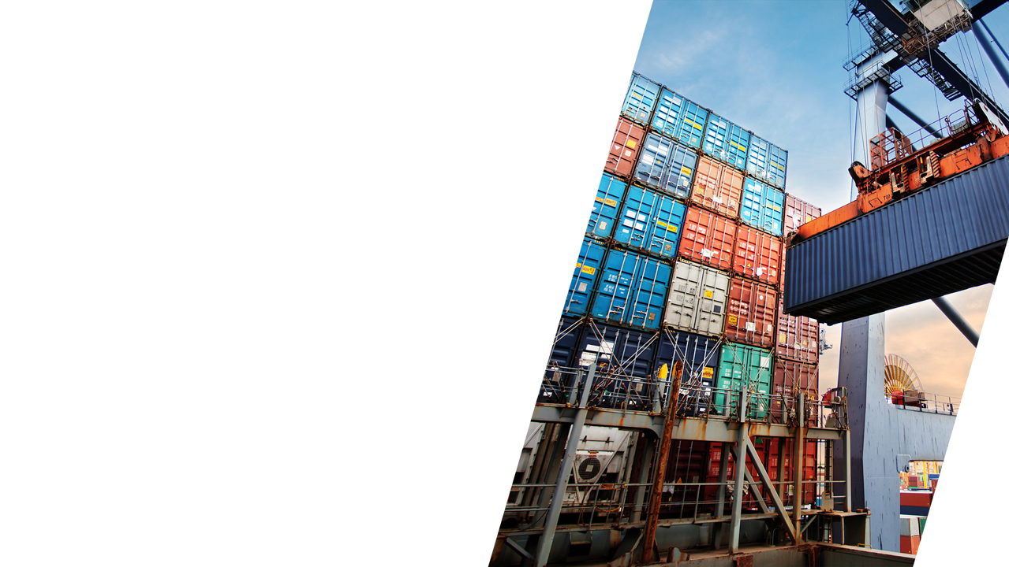
CONTAINERS
EXPLAINED IN
LESS THAN 5’
(but don’t pretend it’s an exhaustive explanation)

Slide 12
LINUX
(and most of modern OSs)
Process 0
Process 1
Process 2
Filesystem
Kernel
Hardware

Slide 13
HARDWARE VIRTUALIZATION
Virtual Machine 0
Virtual Machine 1
Process 0
Process 1
Process 2
Process 0
Process 1
Process 2
Filesystem
Filesystem
Kernel
Kernel
Virtualized Hardware
Virtualized Hardware
Hypervisor
Hardware

Slide 14
CONTAINERS
Container 0
Container 1
Process 0
Process 1
Process 2
Filesystem
Filesystem
Kernel
Hardware

Slide 15
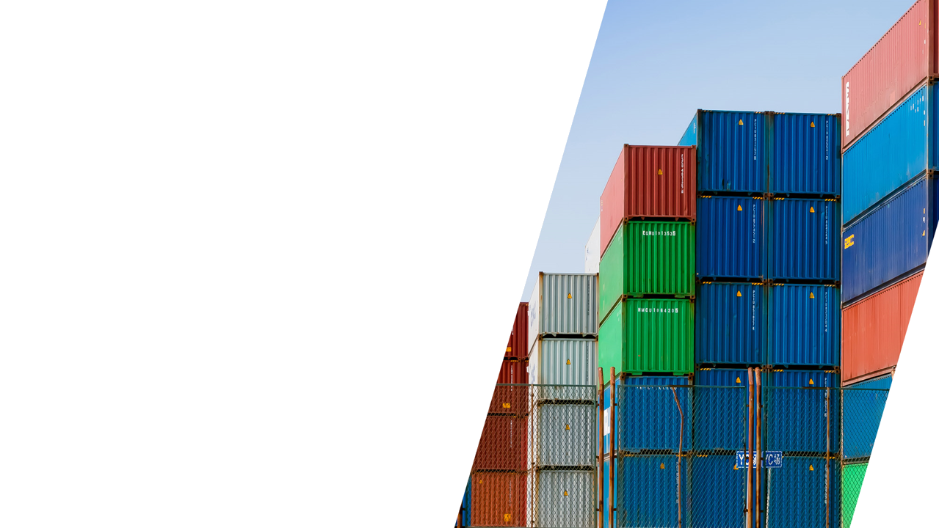
CONTAINER
ADVANTAGES
An application and his dependencies can be “packed” inside a single shipment unit
Container runtime can easily deploy and run containers on top of an existing operating system
Runtime and tools can operate on containers using different distributions and packages
Resource usage and access can be limited for applications running inside a container

Slide 16
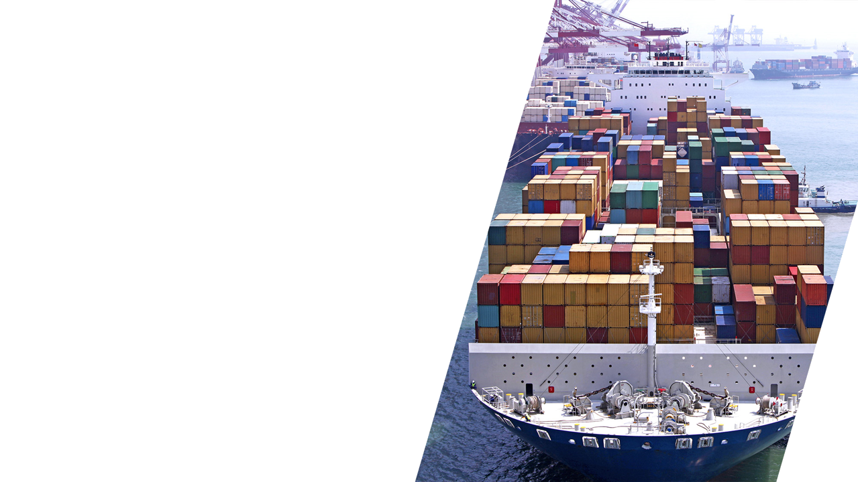
CONTAINER
ADVANTAGES (continued…)
Containers don’t have the extra overhead required for hardware virtualization
Layers can be shared, making deployment much faster
Runtime instances could be easily created and destroyed

Slide 17
CONTAINER
DRAWBACKS
Extra storage is needed
Each container has a different user mode filesystem, no shared libraries between containers
Extra memory is needed
Duplicated libraries, runtimes
Sandboxing
Limited access to hardware
File access overhead due to layers
Less isolation
Containers may be less secure than VMs

Slide 18
CONTAINERS
AND
DEVICES

Slide 19
CONTAINERS ON
EMBEDDED DEVICES
We will waste a lot of resources!
We don’t need high level languages and frameworks on a device (see point 1)!
Containers are designed for servers!
Process isolation is enough!
This will add complexity to our development cycle!
If we can’t access hardware directly we will lose performances!
Things invented for web development are for hipsters!

Slide 20
ALTERNATIVES TO
CONTAINERS
Hypervisor and Linux kernel (real-time and non-real time)
Heterogeneous multi-core (multiple OSs on different cores)
“Containerized” application model (ex: Android apps)

Slide 21
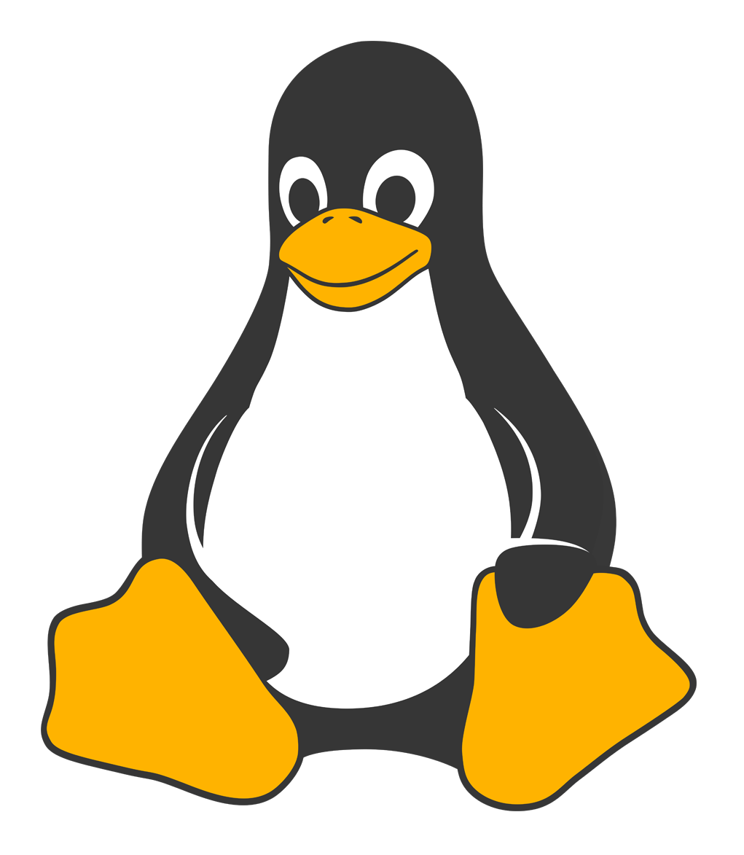
WHAT ABOUT…
LINUX?
Born as a multi-user server OS, now widely used on billions of devices
Process isolation by default
HW is accessible only in kernel mode
Multi-user by design
Devices uses lots of high-level frameworks and tools originally developed for PCs and servers.

Slide 22
LINUX ON
EMBEDDED DEVICES
Today Linux can be used to build devices that
Get to market quickly
Are secure
Are future-proof

Slide 23
CHANGE YOUR
PERSPECTIVE
Devices are more and more often part of a complex solution
Containers can be “building blocks” that will help you in developing your software using multiple tools
Base OS provides the services that your containers need and a secure way to manage them

Slide 24
WILL CONTAINERS REPLACE
LINUX APPLICATIONS?
Linux has been widely adopted in embedded, mostly in complex devices
One size does not fit all, Linux did not replace firmware/RTOSs on all devices, containers will not replace Linux applications on all devices.
Devices are getting more complex, connected, more critical for the infrastructure of a company or an organization
“Containerization” is an option you should evaluate if you want to build a modern solution reducing development and maintenance costs

Slide 25
SOLUTIONS USING
CONTAINERS
Azure IoT Edge (Microsoft)
Fedora IoT (RedHat)
MBED Linux (Arm)
Linux Microplatform (Foundries.io)
Balena
Torizon (Toradex)

Slide 26
CONTAINERS
AND
QT

Slide 27
QT AND CONTAINERS
Why should I run a Qt application in a container?
Keep application independent from BSP
Use different runtimes
Encapsulate application dependencies

Slide 28
QT IN CONTAINERS
Generic Linux distribution
Packages already available
Similar do development on PCs
Qt for Python
Boot2Qt
More optimization
Commercial license available
Dedicated application model

Slide 29
QT IN CONTAINER
Wayland Server Container
QT application
on Debian
Wayland (socket)
Boot2Qt Application
Wayland + openGL
Legacy application using X
XWayland
X11 (socket)
Hardware

Slide 30
DEMO

Slide 32
THANK YOU FOR YOUR INTEREST.

Slide 33
Useful
Links
Boot 2 Qt
Torizon

